Slide 1
Winston Churchill
The greatest person in British history
By:Rosca Dorin TI-216
Teacher:Crudu Corina

Slide 2
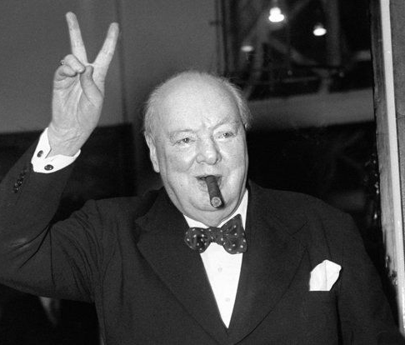
Broadcast
In 2002 BBC made an television poll where people from Great Britain decided who is the greatest Briton in their history
In that poll where many influent and important for Britain history personalities from Guy Fawkes, Oliver Cromwell, Richiard III to Princess Diana but the greatest was named Winston Churchill

Slide 3
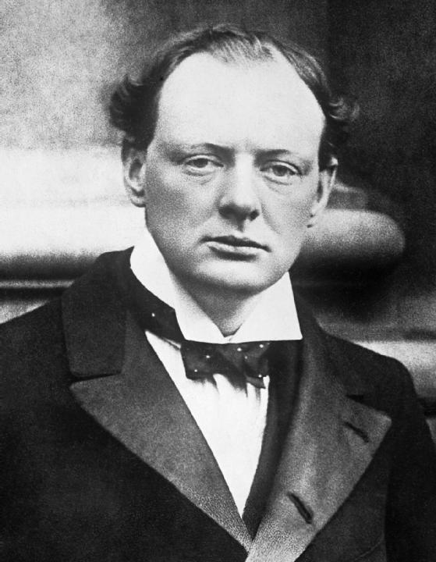
Biography
Sir Winston Leonard Spencer Churchill (1874-1965), the son of Lord Randolph Churchill and his American wife Jennie Jerome, was educated at Harrow and Sandhurst. After a brief but eventful career in the army, he became a Conservative Member of Parliament in 1900. He held many high posts in Liberal and Conservative governments during the first three decades of the century. At the outbreak of the Second World War, he was appointed First Lord of the Admiralty – a post which he had earlier held from 1911 to 1915.

Slide 4
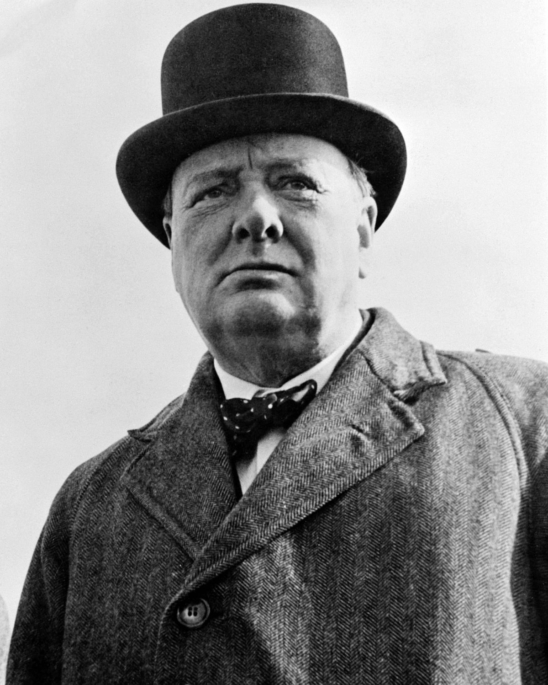
In May, 1940, he became Prime Minister and Minister of Defence and remained in office until 1945. He took over the premiership again in the Conservative victory of 1951 and resigned in 1955. However, he remained a Member of Parliament until the general election of 1964, when he did not seek re-election. Queen Elizabeth II conferred on Churchill the dignity of Knighthood and invested him with the insignia of the Order of the Garter in 1953.
QUANTITIES
netus nibh aliquet, porttitor ligula justo libero vivamus porttitor dolor, conubia mollit. Sapien nam suspendisse, tincidunt eget ante tincidunt, eros in auctor fringilla praesent at diam. In et quam est eget mi. Pellentesque nunc orci eu enim, eget in fringilla vitae, et eros praesent

Slide 5
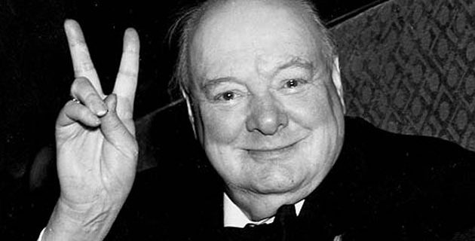
He was also a Sandhurst-educated soldier, a Nobel Prize-winning writer and historian, a prolific painter, and one of the longest-serving politicians in British history.
during most of World War II, Winston Churchill rallied the British people and led the country from the brink of defeat to victory. He shaped Allied strategy in the war, and in the war's later stages he alerted the West to the expansionist threat of the Soviet Union.
Winston Churchill inspired others through speeches during a time of uncertainty. This inspiration is heroic as it gave people hope. He rose beyond the call of duty when he did this and this is why he is considered the greatest person in British history

